Slide 1
Web Application Security
By –Pratik S. Patel, Assistant Professor(Cyber Security), National Forensic Sciences University

Slide 2
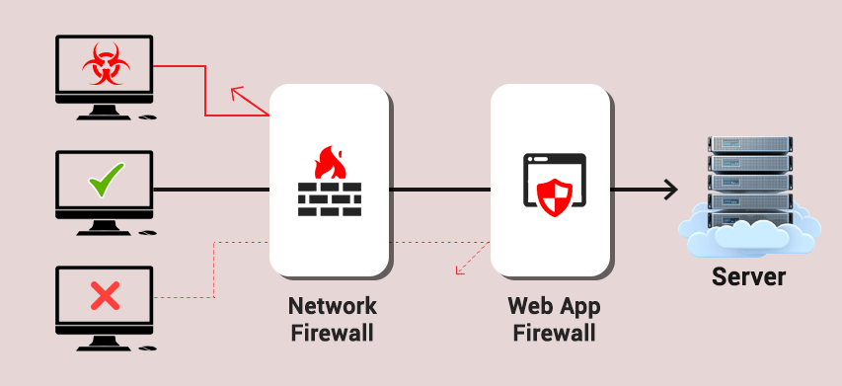
Web Application Firewall (WAF)
A web application firewall (WAF) is a specific form of application firewall that filters, monitors, and blocks HTTP traffic to and from a web service.

Slide 3
Sec_Term
Reverse Proxy:-A reverse proxy server is an intermediate connection point positioned at a network’s edge. It receives initial HTTP connection requests, acting like the actual endpoint.
Forward Proxy:-A forward proxy is what most people call 'a proxy'. You send a connection request to it, and the forward proxy retrieves data from the internet. It usually lets clients on an otherwise firewall-restricted network to access the internet.
Policies:-A WAF operates through a set of rules often called policies
Whitelist:-Whitelisting is the practice of explicitly allowing some identified entities access to a particular privilege, service, mobility, access or recognition.
Blacklist:-The blacklisting approach involves defining which entities should be blocked.
Transparent Reverse Proxy:-A reverse proxy with transparent mode. As a result, the WAF separately sends filtered traffic to web applications
Transparent Bridge:-HTTP traffic goes directly to the web application

Slide 4
TYPES OF WAF
Network-based WAF:-it is a hardware that installs to your device in order to track on all your data packets to and from the website.
Host-based WAF:-Host-based web application firewalls (HWAF) exist as modules for a web server
Cloud-based WAF:-Cloud-based web application firewalls provide similar benefits as other software-based WAF solutions, such as low cost and the lack of on-premises resources that you must manage.
How WAFs Work??
Using a set of rules to distinguish between normal requests and malicious requests
Sometimes they use a learning mode to add rules automatically through learning about user behavior

Slide 5
Operation Modes:
Negative Model (Blacklist based):- blacklisting model uses pre-set signatures to block web traffic that is clearly malicious, and signatures designed to prevent attacks which exploit certain website and web application vulnerabilities.
Positive Model (Whitelist based):-A whitelisting model only allows web traffic according to specifically configured criteria. For example, it can be configured to only allow HTTP GET requests from certain IP addresses.
Mixed/Hybrid Model (Greylist or Inclusive model):- hybrid security model is one that blends both whitelisting and blacklisting.

Slide 6


